Slide 1
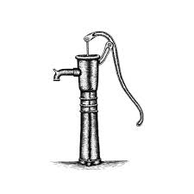
Water Pump Functionality Prediction
Godwin Emeriego
Gamaliel Toka

Slide 2
Outline
Project recap
Data exploration
Research questions and analytical insight
Summary
Project recap
Project Questions
Process
Insight
Summary

Slide 3
Project recap
The project was assigned to predicts the functionality status of water pumps across Tanzania using machine learning.

Slide 4
Data Exploration
Dataset structures:
59400 rows and 40 columns.
3 floats, 7 numeric and 30 objects variables

Slide 5
Research questions and analytical insight
Research Questions:
Does water quantity influence pump functionality?
How does the installer relate to long-term functionality?
Which pump types have the highest proportion of non functional pumps?
Do older pumps fail more often than newer ones?
What is the proportion of failure base regions?

Slide 6
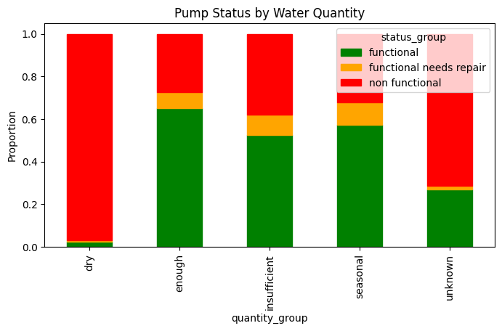
Does water quantity influence pump functionality
Insight
The pumps at the areas with less water are more prone to failure due to obvious reasons.

Slide 7
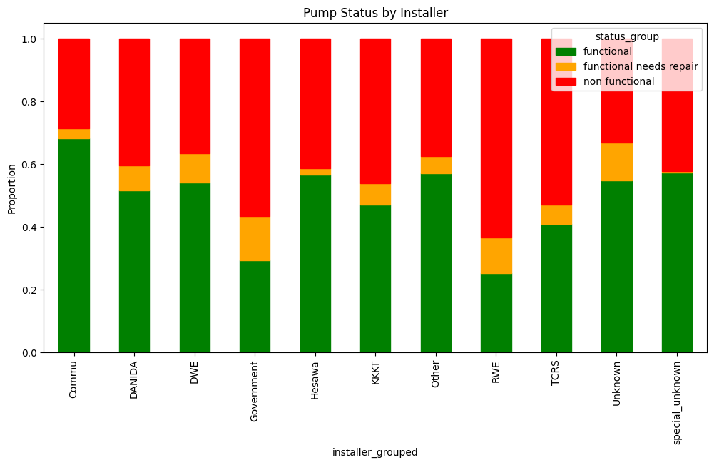
How does the installer relate to long-term functionality?
RWE and Government installed pumps seem to be more likely to fail.

Slide 8
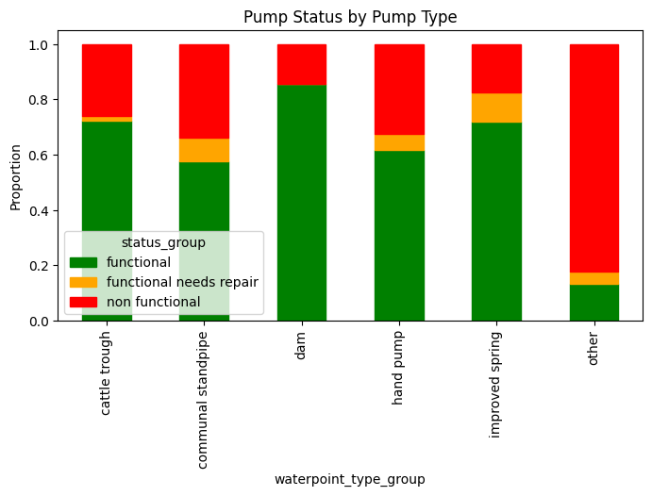
Which pump types have the highest proportion of non functional pumps?
“Other” and “communal standpipe” pump types are the most unreliable, with the highest proportion of non working pumps.

Slide 9
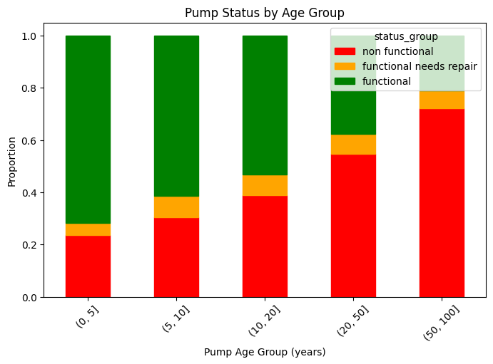
Do older pumps fail more often than newer ones?
The older the pump, the higher the likelihood it has failed. This suggests age is a strong factor in pump functionality.

Slide 10
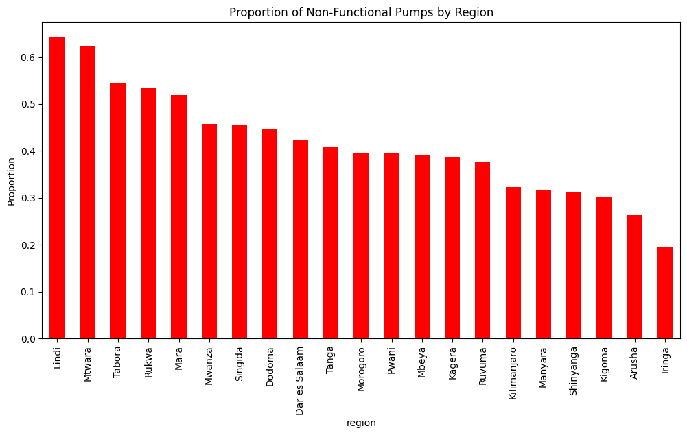
Are certain regions more prone to pump failures
There are more failure in lindi than other regions
.

Slide 11
Summary
Older pumps are more likely to fail because wear accumulates over time, so age becomes a strong risk factor. Likewise, some regions show more failures than others, which points to differences in climate, groundwater conditions, maintenance access, or spare-part availability. Pump type also matters because some designs are more durable or better suited to certain operating conditions than others. Installer quality appears important too. If pumps installed by some organizations fail less often, that suggests better workmanship, installation standards, or follow-up maintenance. Water quantity can also affect reliability because pumps serving scarce or heavily used sources may be under more stress, which increases breakdown risk.

Slide 12
Thank you all for your time

